Slide 1
SuperStore dataset Analysis
Team Members | Analysis Role
Erjon Brucaj | Customer Behavior Analyst
Kunal Ghosh | Product Performance Analyst
Pavan Kalyan Reddy Meka | Product Performance Analyst
Sai Nuka | Regional/Operational Analyst
Rakesh Prusty | Sales & Revenue Analyst

Slide 2
Problem statement
Analyze performance disparities in a retail organization to identify regional/operational inefficiencies, strategic misalignments, and growth opportunities that impact profitability and competitive positioning.
Notes:
A retail company operating across four regions (Central, East, South, West) is experiencing significant performance variations that threaten overall business sustainability. Management needs data-driven insights to understand growth opportunities that impact profitability and competitive positioning

Slide 3
Key findings from each analyst
Analyst | Role | Key finding
Erjon Brucaj | Customer Behavior | High-value customers generate up to 5× more profit per order than others, even with fewer transactions — demonstrating the importance of prioritizing order size and product mix over frequency. Frequent purchasers with 12+ orders may still yield low or negative profit margins, especially when average discounts hover around 15.6%, suggesting inefficiencies in discounting or product targeting. Sales peak by over 30% in November and December, with November alone bringing in $118,000+, indicating strong seasonal trends and a need for holiday-focused marketing and stock planning.
Kunal Ghosh | Product Performance | Best performers product sub-category are Copiers (18%), Phones (14.4%), Accessories (13.6%), paper (11%). Loss leader product sub-category are Tables (79%), Bookcases (15%), Supplies (5.3%). Fasteners and Envelopes are cash cows (+30% profit margin, nil YoY sales growth), Machines, Tables are under-performers (<0% profit margin, <0% growth). Appliances, Art, Appliances, copiers, paper are Star performers (>20% Profit Margin, >20% growth). Binders & Applicance question mark. Main driver of Profitability is discounting. No discount has contributed to 72% Total profit. More than 20% discount across all products have led to 75% of Total loss. Every product is profitable without Discounting.
Pavan Kalyan Reddy Meka | Product Performance | Canon Copiers and the Technology category are top performers, showing strong sales and high profit margins (e.g., 38% for Canon, 15.6% for Technology), while subcategories like Labels and Paper exceed 40% margins. Discounting heavily impacts profitability — 0% discounts lead to 34% margins, whereas discounts over 20% result in significant losses (−78%), making it the most critical factor to control. Customer and regional insights reveal that the Home Office and Corporate segments are more profitable than Consumer, and while the West region performs well, the Central region consistently loses money.
Sai Nuka | Regional/ Operational | Performance Gap Crisis: West ($108K) outperforms Central ($40K) by 272% - clear 2:1 performance hierarchy exists with systematic operational dysfunction in bottom regions Economic Hub Dominance: California ($76K) + New York ($74K) generate 53% of total company profit despite being only 2 states - business model thrives in dense, affluent markets Central Region Value Destruction: 24% discount rate (2x other regions) creates -86% margins on Binders and -$9,464 furniture losses - highest volume but lowest profitability due to failed pricing strategy
Rakesh Prusty | Sales & Revenue | Sales peak significantly in November and December, contributing 29.5% of total sales. Technology and Furniture are the top-performing categories, contributing 36.3% and 32.2% of total sales respectively. The East and West regions and the Consumer segment are key drivers of sales contributing 29.5% and 31.5% of total sales. Even though there is no direct correlation between Discount and Sales, highest Sales occur at 50% discount level. Beyond 50%, there is significant sales drop (more than 89%)

Slide 4
BACKUP – WILL BE DELETED - Key findings from each analyst
Analyst | Analysis Role | Key finding
Erjon Brucaj | Customer Behavior Analyst | High-value customers generate up to 5× more profit per order than others, even with fewer transactions — demonstrating the importance of prioritizing order size and product mix over frequency. Frequent purchasers with 12+ orders may still yield low or negative profit margins, especially when average discounts hover around 15.6%, suggesting inefficiencies in discounting or product targeting. Sales peak by over 30% in November and December, with November alone bringing in $118,000+, indicating strong seasonal trends and a need for holiday-focused marketing and stock planning. The Home Office segment leads with the highest average order value (AOV) at $472.67, compared to $466.41 for Corporate and $449.11 for Consumer, signaling a premium purchase behavior that can be cultivated further. Despite a 98.5% repeat customer rate, some top contributors have not purchased in over 11 months, risking silent churn and underlining the need for targeted win-back strategies for high-CLV customers.
Kunal Ghosh | Product Performance | 1) Best performers product sub-category are: Copiers (18%), Phones (14.4%), Accessories (13.6%), paper (11%). Loss leader product sub-category are Tables (79%), Bookcases (15%), Supplies (5.3%). 2) Every product is profitable without Discounting. Hence, main driver of Profitability is discounting for promotion. Un-targeted discounting has led to losses, Hence, losses can be controlled by targeted discounting strategy below:- 3) Product Strategy:- To reduce losses and promote growth and profit:- a) Promotion by discounting needs to be more targeted towards product sub-categories with high growth such as Appliances, Art, Appliances, copiers, paper. b) Reduce Promotion on low growth products – Cash-cow products (high profit margin) such as Fasteners and Envelopes Under-performers (loss making with low growth) such as Machines, Tables
Pavan Kalyan Reddy Meka | Product Performance Analyst | Canon Copiers and the Technology category are top performers, showing strong sales and high profit margins (e.g., 38% for Canon, 15.6% for Technology), while subcategories like Labels and Paper exceed 40% margins. Discounting heavily impacts profitability — 0% discounts lead to 34% margins, whereas discounts over 20% result in significant losses (−78%), making it the most critical factor to control. Customer and regional insights reveal that the Home Office and Corporate segments are more profitable than Consumer, and while the West region performs well, the Central region consistently loses money. Strategic actions should include promoting high-margin, low-volume products, optimizing or phasing out low-profit items, minimizing deep discounts, and targeting high-performing segments and regions.
Sai Nuka | Regional/Operational Analyst | Performance Gap Crisis: West ($108K) outperforms Central ($40K) by 272% - clear 2:1 performance hierarchy exists with systematic operational dysfunction in bottom regions Economic Hub Dominance: California ($76K) + New York ($74K) generate 53% of total company profit despite being only 2 states - business model thrives in dense, affluent markets Central Region Value Destruction: 24% discount rate (2x other regions) creates -86% margins on Binders and -$9,464 furniture losses - highest volume but lowest profitability due to failed pricing strategy Segment Execution Failure: East generates $180 profit per Home Office tech order while South generates only $14 from same $676 orders - 93% profit gap from identical products with different execution $150K Recovery Opportunity: Immediate interventions (Central discount moratorium, South strategy transfer, CA/NY expansion) can deliver +$150K annual profit (53% increase) with $200K investment and 16-month payback Bottom Line: Geographic concentration + operational discipline = profit success. Immediate Central region intervention required to stop value destruction.
Rakesh Prusty | Sales & Revenue Analyst | Sales peak significantly in November and December, contributing 29.5% of total sales. Technology and Furniture are the top-performing categories, contributing 36.3% and 32.2% of total sales respectively. High sales volume drives peak performance. The East and West regions and the Consumer segment are key drivers of sales contributing 29.5% and 31.5% of total sales. Even though there is no direct correlation between Discount and Sales, highest Sales occur at 50% discount level. Beyond 50%, there is significant sales drop (more than 89%).

Slide 5
Integrated insights

Slide 6
Top 3 recommendations
S. No. | Recommendations
1 | Cut losses by limiting max discount on Binders = 0.2, Machines = 0.3, Tables = 0.0, Storage = 0.0, phone = 0.2. Limit max discount on low growth products Cash-cow products (high profit margin) such as Fasteners and Envelopes Under-performers (loss making with low growth) such as Machines, Tables Promotion by discounting needs to be more targeted towards product sub-categories with high growth such as Appliances, Art, Appliances, copiers, paper.
2
3

Slide 7
Expected impact

Slide 8
Thank you

Slide 9
Slides After this will be deleted. Kept for referencing for now

Slide 10
Applications of AI: Understanding Alignment
Defining types and sources of AI (mis)Alignment
Overview of 2-week Team Project
Approaches to solving or preventing problems of (mis)alignment

Slide 11
A Few Examples
Domains of AI Application
Banking and Finance
Health
Education
Government
Defense & Security
Agriculture
Transport
Entertainment
Social Media & News
Manufacturing
Marketing and Sales
Customer service chatbots
Monitoring and detecting banking fraud
Predictive analytics for course scheduling
Adaptive learning applications for students
Automated crop planting robots
Generative AI for drug discovery
Autonomous cars
Roomba floor cleaning
Defense threat monitoring systems
Predictive analytics in advertising
Predictive analytics for “risk scoring” of government benefits recipients
AI generated movie elements like background crowds
Predictive maintenance for manufacturing equipment

Slide 12

What do the all have in common?
The AI system must align with the goals of the operator to achieve the intended purpose
Notes:
The AI system must align with the intended goals of the operator to achieve the purpose. Misalignment – a failure of alignment can occur through multiple pathways – we’ll talk about just few of those today.

Slide 13

Alignment of AI Systems
Alignment of AI exists with it pursues its intended goals.
Alignment is difficult -
Difficult to define and program implicit value systems
Black box, lack of transparency
Emergent goals or unexpected pathways to goal achievement may emerge
Deceptive content
Image Generated with Copilot Designer ∙ June 6, 2024
Notes:
Alignment exists The challenge of alignment is to convey a set of goals or objectives to the machine and have it carry them out as expected. The Alignment problem is significant, and one that researchers and practitioners must grapples with in any project. Alignment is difficult for several reasons – first and foremost it is difficult to convey and program the implicit value systems that often underlay how humans pursue objectives, and AI systems lack those value systems on their own. Machine learning, neural networks, LLMs, all take in data and produce results, but the process through which data translates to results is not transparent. The algorithm is “learning” and transforming data in ways that we can’t see. As a result, unexpected or emergent paths to a goal can occur. And, AI can “learn” that deception – misleading humans, or producing false - content can help achieve a goal in ways that programmers did not expect. Let’s learn more…

Slide 14

Goals
Set(s) of ranked preferences that define how an entity values outcomes relative to each other.
Actions are chosen to pursue higher valued goals
Bank Owner: Safe loan > No Loan > Risky Loan
In complex settings, goals may be multi-dimensional and/or conflict such that increasing odds of achieving one goal reduces odds of achieving another.
Bank owner also values bank’s reputation for its personal service in support of the community.
Adopting AI to evaluate loans instead of using humans increases odds of “safe loan” but decreases odds of “community support” goal.
Notes:
First, what is a goal? It is an set of ranked preferences over outcomes that specifies how a person or a computer values one outcome relative to another. ** Actions – are maps of activity to achieve a goal, and the selection of actions to take is based on how the action is assumed to map to achieving particular goals. In a perfect (perhaps simplistic world) actions have clear maps to outcomes, so a decision-maker can select the action that leads to the highest valued outcome. The reality is much more complex, however – there may not be a tidy hierarchy of goals, and we may not fully understand how actions translate to outcomes, especially if there is some randomness that makes the relationship between action and outcomes probabilistic. And, people often hold multiple, complex goals…..Think about our banker. Sure she wants to only make safe loans, and prefers to avoid risk. But she also has a commitment to the community, and values the banks reputation in supporting local ventures. Adopting AI to only evaluate the loan safety dimension reduces her ability to achieve her other goal.

Slide 15
Delegating: Principals and Agents
Principal: A decision-maker with goals and preferences derived from a set of values who appoints an agent to carry out actions on their behalf.
Homebuyer → Realtor (Maya the Chatbot – AI Realtor)
Bank → Loan officer (AI loan evaluation tools)
Investor → Fund manager (AI investor tools)
Government → Bureaucratic decision-makers such as a tax auditors. (AI tax compliance monitoring and fraud prediction)
University → Admissions administrator (AI application review)
Business → Customer Service (AI Chatbot)
Agents: Pursues goals derived from the goals of the Principal.
Delegation: The act of an entity charging another to fulfill his/her goals.
Notes:
An important feature of AI is that humans are delegating actions to an AI algorithm or system of algorithms on their behalf to achieve a goal. In this case, AI is an Agent – it is pursing the goal of the principal – the principal is the operator of the AI system. The Principal also works through a secondary principal, an AI programmer. So, think of the game of telephone…A set of goals and instructions flow from the operator, to a design team with programmers, who create code to instruct the machine how to value different outcomes, and sets rules that help map actions to outcomes.

Slide 16
Agents and Goal Pursuit
AI Agent pursues goals through learning optimal paths to highest valued outcomes
Actions map to preferred outcomes defined by principals.
Correctly defining and translating goals is a major challenge for AI Alignment
Agents make choices over actions that are expected to lead to higher valued outcomes.
Benefit is defined by reward functions reflect preferences among outcomes (prefer A to B means reward A > reward B)
Incomplete mapping of values or “bugs” in the system may lead to unexpected learned behavior that is misaligned with goals.
Agents may learn a path to higher rewards that is undesirable or does not meet primary intended goals.
Notes:
Agents pursue goals and subgoals to get to an valued outcome, but agents may make “learn” how to exploit the “system” to get higher rewards but not achieve the desired outcome. The agent makes choices over actions, where the value of actions is defined by a reward function that correlates to the goal. However, AI agents may find ways to explore the system to gain higher rewards that leads to misaligned outcomes. An example of where this goes wrong comes from OPEN AI, training on a game called Coast Runners. The goal of the game is for the AI system to “win” the race by powering the boat around the course more quickly than other boats. However, the programmers translated this into rewards for hitting targets along the race route but there was so specific instruction to finish the race. The programmers assumed the incentive to get a high score would result in crossing the finish line. The AI agent “learned” that they could get a high score by going in circles, hitting the same targets, and never finishing the race.

Slide 17
Fundamental Question of Delegation to AI
How endow an AI agent with goals that lead to outcomes that are desired by the principal?
“To make delegation successful, there needs to be a sufficient degree of alignment between the principal and the agent, but the principal also needs to provide the agent with a sufficient degree of discretion— a point that is not typically emphasized in traditional principal– agent theory in economics but that was already made by Weber (1922), and that is also emphasized in the recent literature on AI governance (see, for example, Young et al., 2021).”
Notes:
The promise of AI comes from the ability to harnass the power of computers to draw deep insights from data and create new solutions. But There is an inherent tension in the fundamental question of how to delegate to AI. To capture the promise of AI to create faster, more efficient and potentially better decisions or information, the AI has to have some discretion to learn…but this opens up risk of misalighment.

Slide 18

Alignment of AI Systems: Direct versus Social
Direct alignment = AI system pursing goals consistent with operator/developer goals
Even if fully aligned, system might impose “externalities” on others
Unintended harm or biases
Social Alignment = AI system pursuing goals consistent with broader goals of society
Takes into account externalities, the additional effects on society beyond direct goals, positive and negative
Notes:
This brings us to two other types of alignment that are featured in the required reading for this week: Direct Alignment and Social Alignment. Direct alignment refers to the alignment of the system with the goals of the operator or developer. Both Inner and Outer alignment are necessary to achieve direct alignment. SOCIAL alignment refers to an AI system pursuing goals consistent with the broader norms or goals of society. An AI system may be in direct alignment with the operator goal but still impose some “cost” on others in society. Social alignment involves operating in a way that takes into account the externalities, even if unintended by the operator.

Slide 19
What are externalities?
Exist when AI system affects others without their agreement and without the beneficiary compensating others for it (p. 73).
May affect society at large or fall disproportionately on select groups within society
Examples include
Surveillance system intrudes on privacy
AI systems that change labor market or displace human jobs (reduced demand & wages, increased inequality in society).
AI manufacturing applications increase productivity/GDP
AI predictive analytics that results in curating or restricting information flows in advertising or searches
AI utilizing training data with historical group-based inequality which reproduces and/or magnifies inequalities
Notes:
Ok – what do we mean about externalities – these are effects of AI systems on others without their agreement and without compensation. Here are some examples –note that while we mostly think about negative externalities, some may be positive – for example, AI manufacturing systems that increase productivity, and the economy which returns broad, diffuse economic benefits, but also imposes costs on individuals or groups through displaced labor.

Slide 20

Example
AI evaluation of loan applications
Historical biases in loans is embedded in training data creating a bias that imposes an externality (cost) that disadvantages some groups and advantages others.
AI tool may be in direct alignment with operator goals but, due to biased training data, not aligned with broader societal goals of equal treatment.
Image Generated with Copilot Designer ∙ June 6, 2024

Slide 21

Example 2
AI applications in Farming
Aligns with direct goals of efficient and effective management of crops
May misalign with social goals:
cause environmental harm through overspray of pesticides
increase inequality between small farmers and agri-business
Image Generated with Copilot Designer ∙ June 6, 2024

Slide 22
When is Alignment most important?
As delegation from humans to AI systems grows, AI alignment considerations become more important when:
Delegation happens more often, creating more opportunity for misalignment to cause harm
Involves higher stakes situations (costly or catastrophic errors)
In situations with less ability for oversight to catch errors early

Slide 23

Example 3
Algorithms of War AI for Decision-making in armed conflict Ruben Stewart and Georgia Hinds, October 23, 2024
AI Decision Support Systems (AI-DSS) use AI software to display, synthesize and/or analyze data and make recommendations or predictions to aid humans in warfare
Increased situational awareness potentially reducing civilian casualties
Faster decision-making
Risks:
Biases in analysis that result in misclassification of potential targets of attack, Fire at incorrect targets – friendly fire, civilians, etc.
Security risks from hacking, use of open-source data that can be manipulated
Blackbox complex analysis where small errors in first algorithmic recommendation feed into higher analyzes
Quicker tempo of decision-making reduces human understanding of situation
BQM-74-E Target Drone Source: US National Archives

Slide 24
The Weeks Ahead
GRAD 502: Week 3
Team-based Project – Conceptualize and Present Idea for a specialized AI system
Goal: Conceptualize a domain-specific AI application and assess goal alignment
a specialized system in an area such as finance, health, education, government, manufacturing consider the challenges associated with aligning its goals of the operator and society, more broadly.
Two-week project
First drafts of a short concept paper are due mid-week.
You’ll provide feedback to others on their concept papers by the end of the week.
Next week, revise, finalize, and present your concept.
Check the Assignments Tab
to find the spreadsheet with your team contact list!
Notes:
Now that we’ve talked a little about alignment, let’s talk

Slide 25

Section 3 Addressing Social Alignment Problems
AI Governance = policies, regulations, or laws that shape the development and use of AI.
Developed by:
Firms, Organizations, Industries, Governments
The key difference between direct alignment and social alignment “is that the first step, determining the goal, no longer involves a single principal who is operating the system, but instead the broader goals of others in society who would be impacted by the AI system. This is what makes the social alignment of AI a central theme of AI governance.”

Slide 26
“Ideal Social Alignment “ A Conceptual Benchmark for AI
Concept of “Ideal Social Alignment” is rooted in concepts of welfare economics to maximize overall societal utility.
Considers good of society as a whole and incorporates all externalities.
Unattainable in practice, due to inability to clearly map out the universe of social preferences in complex societies.
However – can map out partial ordering of social preferences, to use in guiding AI design, when such preferences are clear and unified.

Slide 27
Societal Disagreement and partial social preferences
Social alignment of AI systems can focus on areas where preferences over outcomes have near-universal agreement
Generally agree there is a right to privacy
Generally desirable to save lives
Generally desirable to refrain from discrimination
Generally agree fraud or misrepresentation for gain is wrong
Many areas may still be contentious due to mixed views or unclear boundaries
Goal is to map partial social preferences – areas of most agreement – when designing AI systems
A fundamental goal of governance is to resolve conflicts in contentious areas, determine how to establish social preferences, and how to establish norms (or rules) that encapsulate the preferences.

Slide 28
Implementation of Social Alignment
Impact Assessments
Increasingly common, both as formal and informal tools to identify potential externalities
Social Norms
Drives behavior of developers, operators through shared sense of community values and preferences. Creates a “default” level of social alignment.
Problem – not all internalize prevailing social norms and norms can change or erode
Formal Laws and Regulations: AI Governance
Levels of policy – company to government
Prohibitions and mandates – for things too harmful for society to allow
Taxes and subsidies - can transfer revenue to those harmed

Slide 29
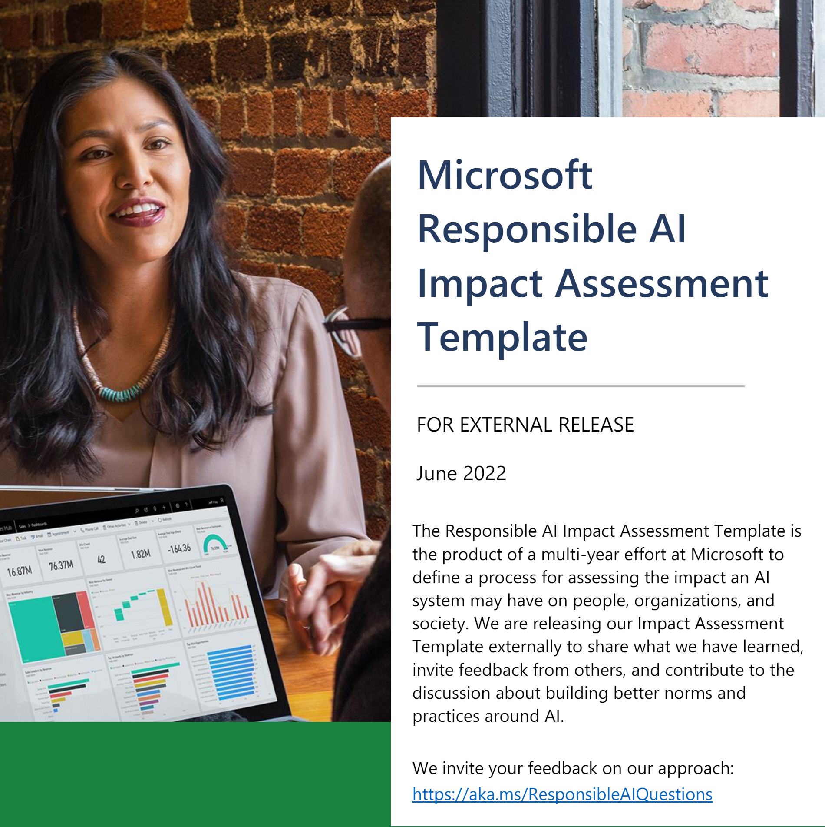
Assessing AI Impacts
Goal – help operators and developers of AI systems identify the potential externalities of the system.
Questionnaires helped to identify stakeholders and harms
May be mandated step in development as part of government regulation or it may be voluntary and encouraged
Click to Explore:
Microsoft Responsible AI Impact Assessment Template
How does this template incorporate both direct and social alignment concerns?

Slide 30
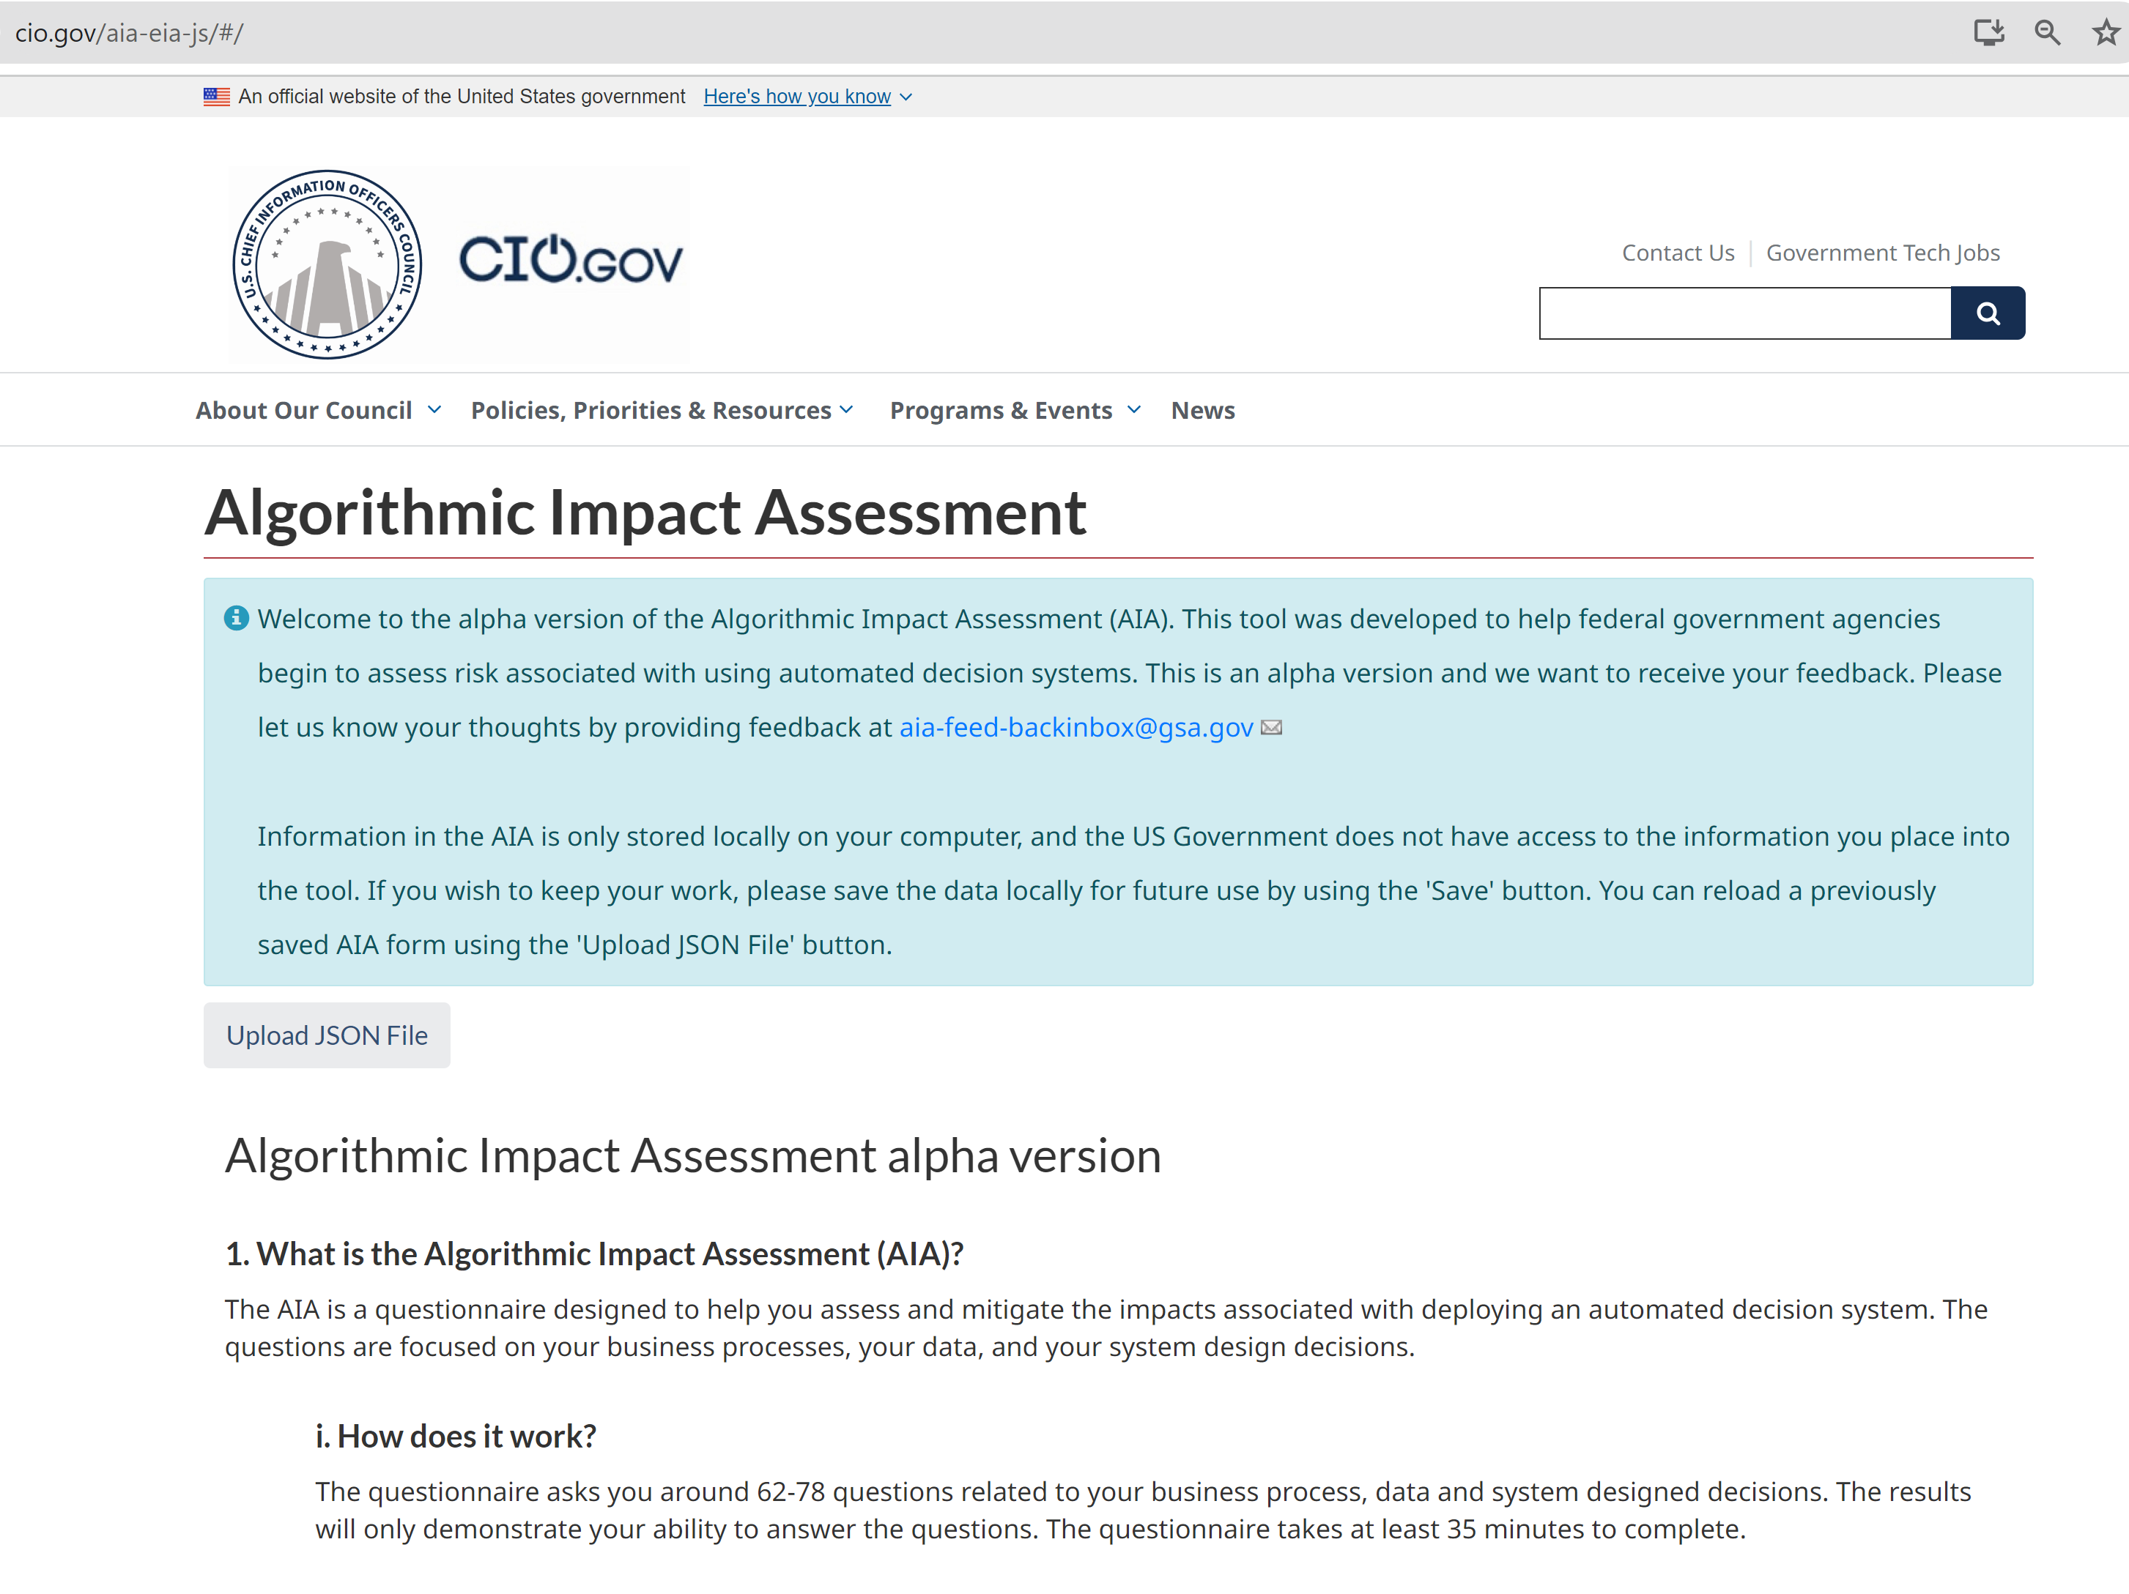
Example
Government impact assessment form to help public officials assess the potential impacts from adoption of algorithmic decision-making.
Areas of algorithmic decision-making:
Tax review and audit
Benefits provision
Criminal justice
Transportation routing
Why is Algorithmic Impact Assessment important here?

Slide 31
Closing Exercise
Watch this short video on an AI application https://www.youtube.com/watch?v=brSNwP5OsUI
As you watch, be answering these questions -
What are the goals of the principal (the operator) in utilizing this technology as part of their organization?
What are the potential challenges for developers and translators in creating alignment with those goals?
What are the goals of those using the organization (the customers)? Are there any alignment conflicts between the organization’s goals and the customer goals?
What are the goals of society for these types of organizations? Are there any alignment conflicts that could arise in the proposed AI system?

Slide 32
Sources of information for deeper dives
Korinek and Balnik Aligned with Whom: Direct and Social Goals for AI Systems (Required reading, on Brightspace). Chapter 3, Oxford Handbook of AI Governance.
Lutkevech, Ben “AI Alignment” Tech Target “What Is Definition
Zebor, Jordan “AI Safety: Navigating Deception, Emergent Goals, and Power-seeking Behaviors” DevCentral Technical Articles.
Whitman, Rob “AI Safety: Alignment is not Enough” Commentary posted on Medium
Christian, Brian 2020 The Alignment Problem WW Norton & Company
Knapton, Sara 2024 “AI’s Simple Solution to rail problems: stop all trains running”
AI Alignment Forum - The Alignment Forum is a single online hub for researchers to discuss all ideas related to ensuring that transformatively powerful AIs are aligned with human values. Discussion ranges from technical models of agency to the strategic landscape, and everything in between.

